Slide 1
OSI Transport Layer
Network Fundamentals – Chapter 4

Slide 2
Objectives
Explain the role of Transport Layer protocols and services in supporting communications across data networks.
Analyze the application and operation of TCP mechanisms that support reliability.
Analyze the application and operation of TCP mechanisms that support reassembly and manage data loss.
Analyze the operation of UDP to support communicate between two processes on end devices.

Slide 3
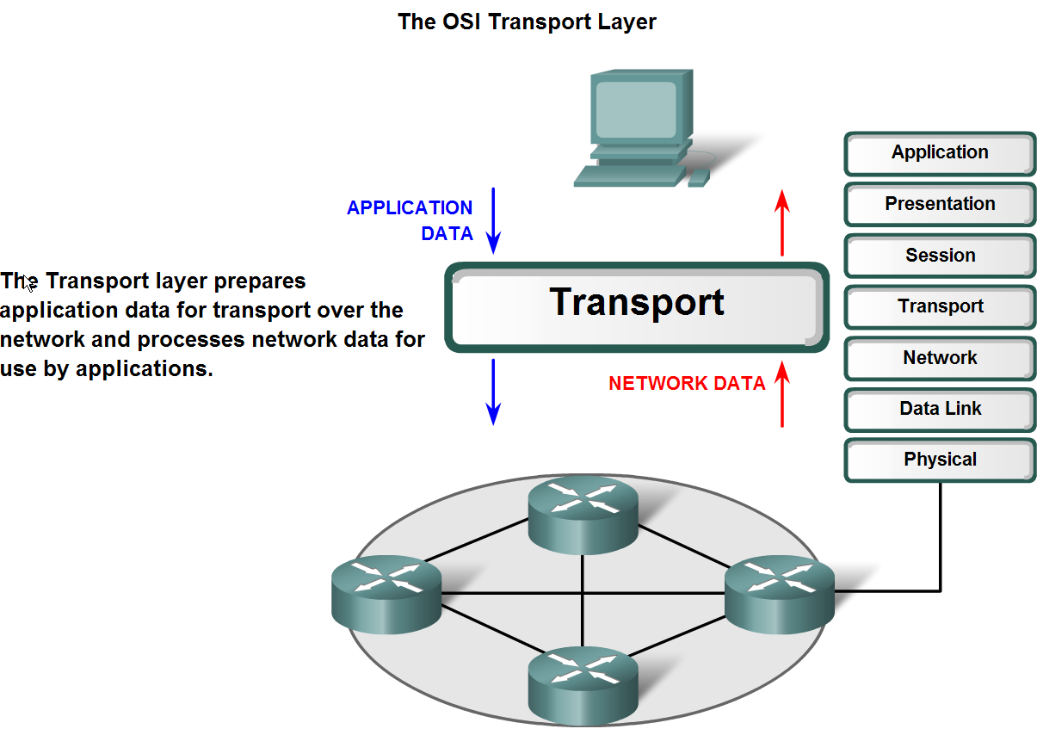
Transport Layer Role and Services
Explain the purpose of the Transport layer

Slide 4
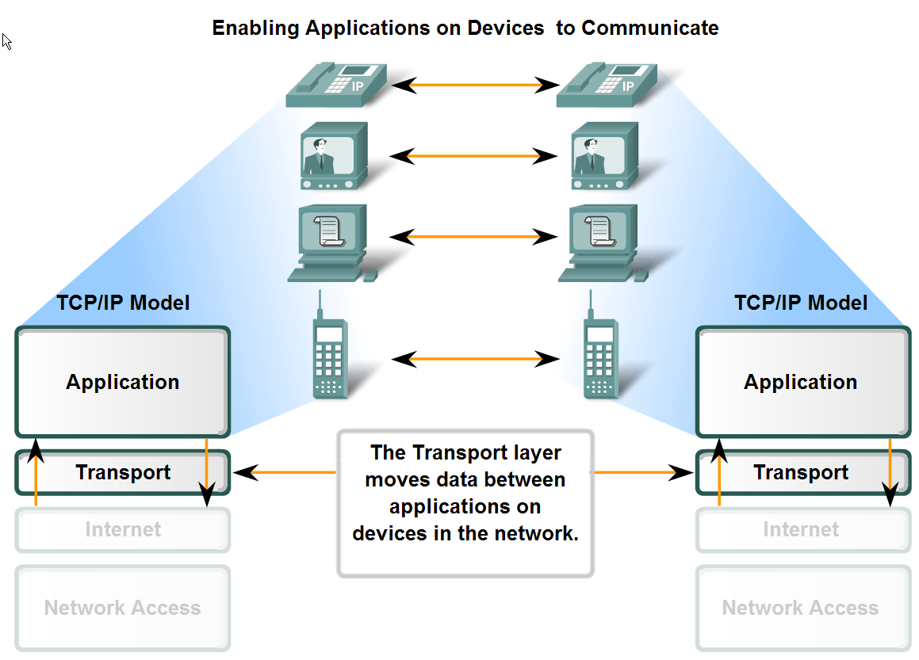
Transport Layer Role and Services
Major functions of the transport layer and the role it plays in data networks

Slide 5
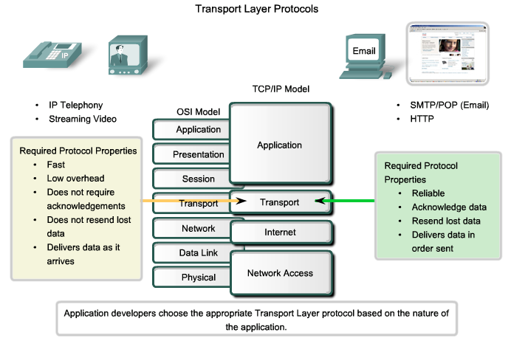
Transport Layer Role and Services
Supporting Reliable Communication

Slide 6
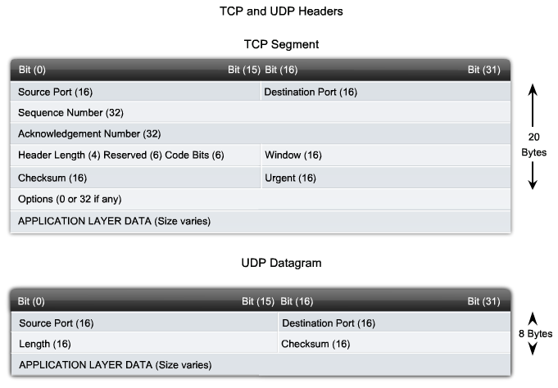
Transport Layer Role and Services
Identify the basic characteristics of the UDP and TCP protocols

Slide 7
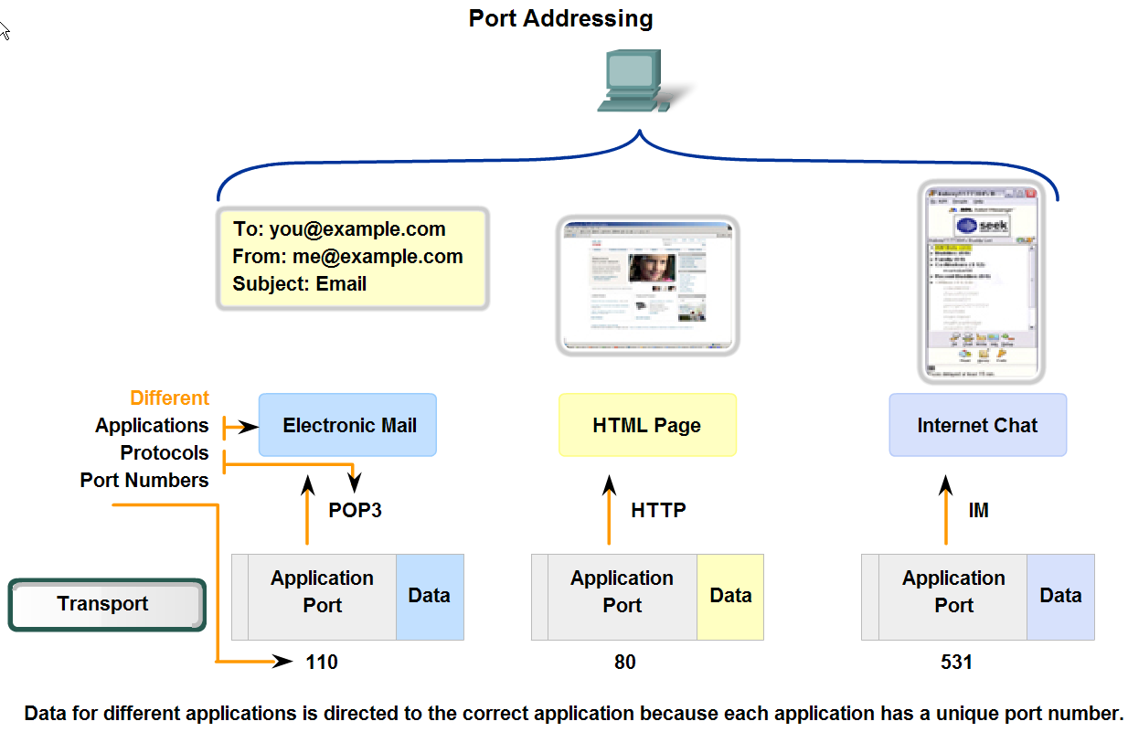
Transport Layer Role and Services
Identify how a port number is represented and describe the role port numbers play in the TCP and UDP protocols

Slide 8
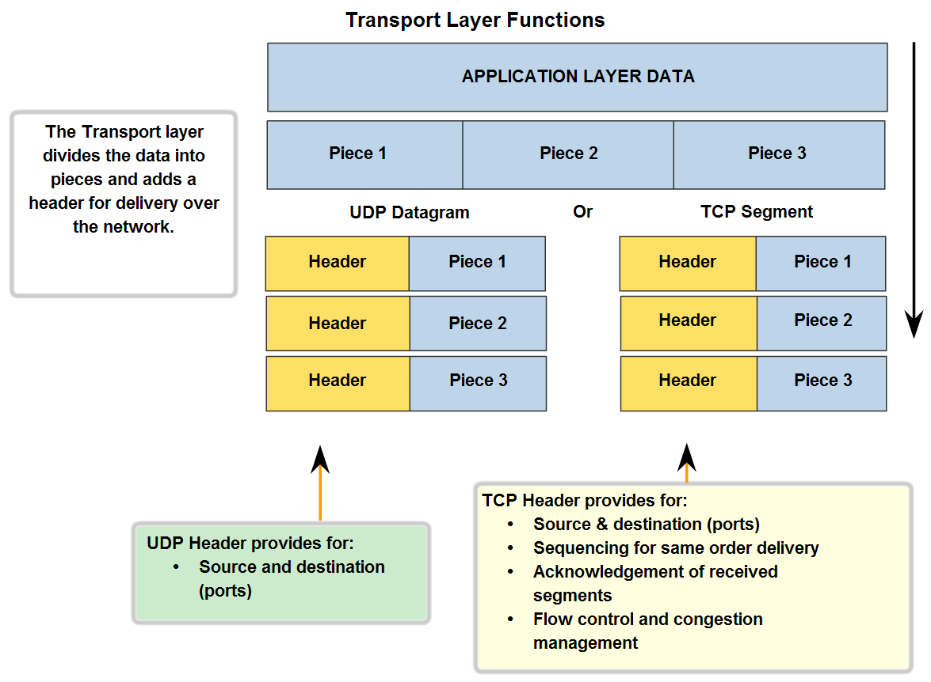
Transport Layer Role and Services
Describe the role of segments in the transport layer and the two principle ways segments can be marked for reassembly

Slide 9
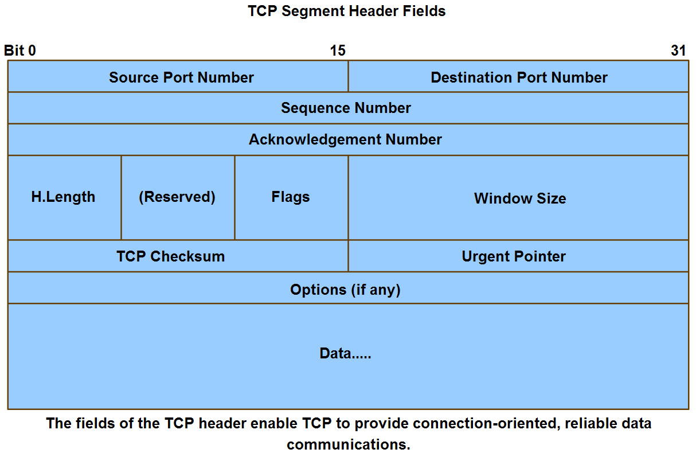
Application and Operation of TCP Mechanisms
Trace the steps that show how the TCP reliability mechanism works as part of a session

Slide 10
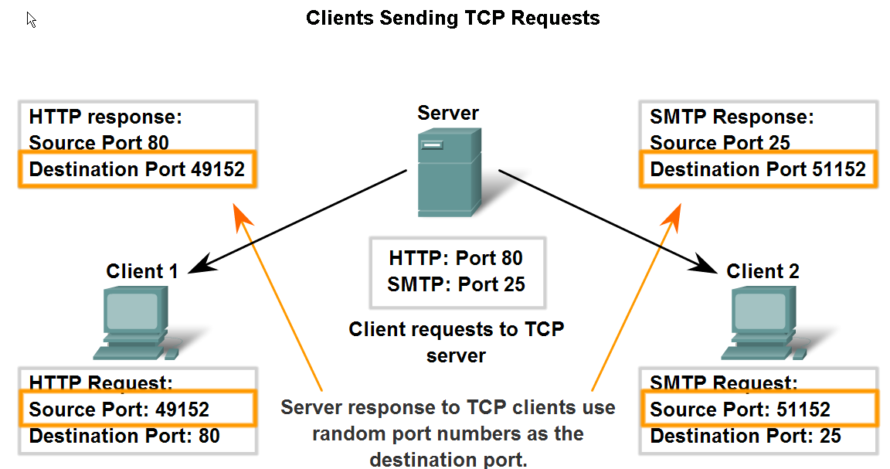
Application and Operation of TCP Mechanisms
Describe the role of port numbers in establishing TCP sessions and directing segments to server process

Slide 11
Application and Operation of TCP Mechanisms
Trace the steps in the handshake in the establishment of TCP sessions
Active participant
Passive participant
(client)
(server)
SYN, SequenceNum =
x
y
,
SYN + ACK, SequenceNum =
x
+
1
Acknowledgment =
ACK, Acknowledgment =
y
+
1

Slide 12
Application and Operation of TCP Mechanisms
Trace the steps in the handshake in the termination of TCP sessions
Active participant
Passive participant
(server)
(client)
FIN, SequenceNum =
x
x
+
1
Acknowledgment =
y
FIN, SequenceNum=
Acknowledgment =
y
+
1

Slide 13
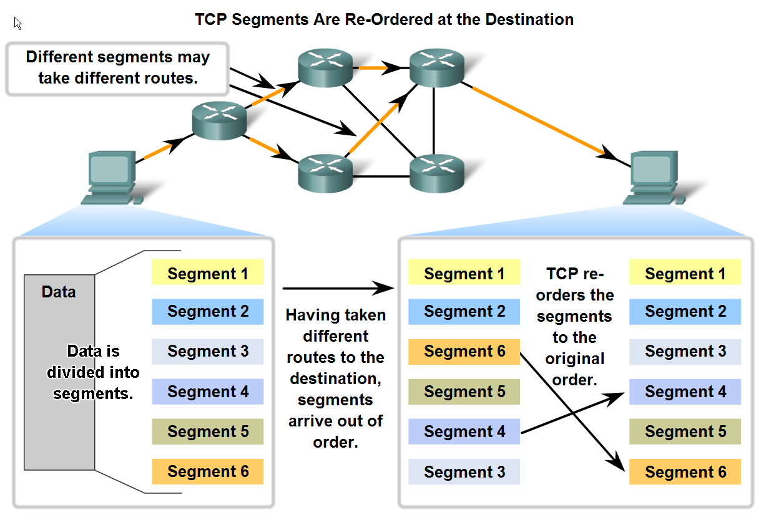
Managing TCP Sessions
Describe how TCP sequence numbers are used to reconstruct the data stream with segments placed in the correct order

Slide 14
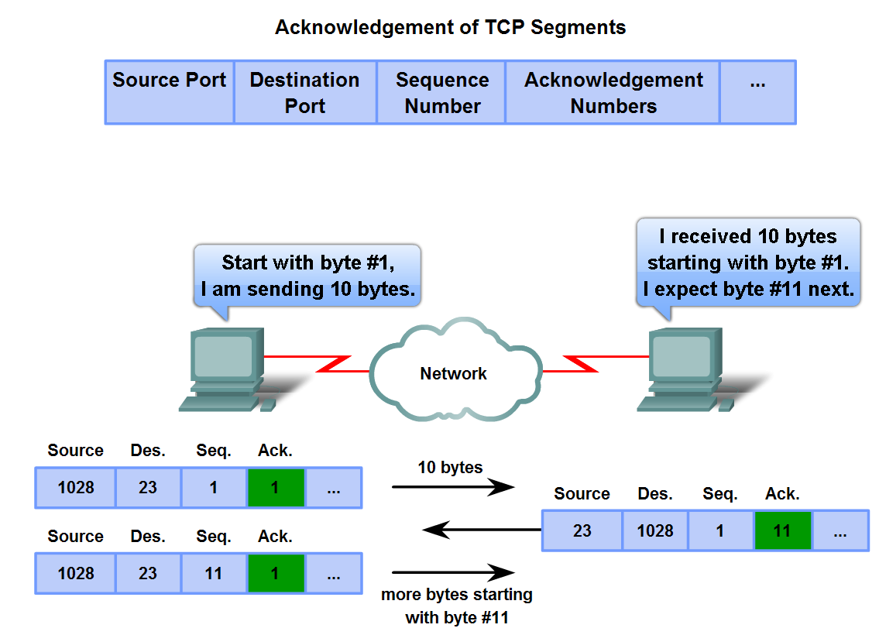
Managing TCP Sessions
Trace the steps used by the TCP protocol in which sequence numbers and acknowledgement numbers are used to manage exchanges in a conversation

Slide 15
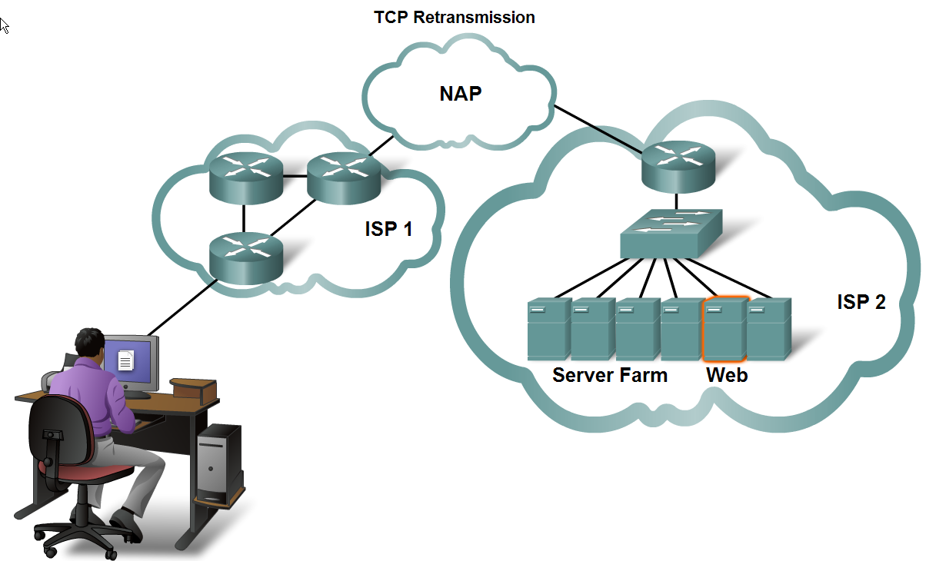
Managing TCP Sessions
Describe the retransmission remedy for lost data employed by TCP

Slide 16
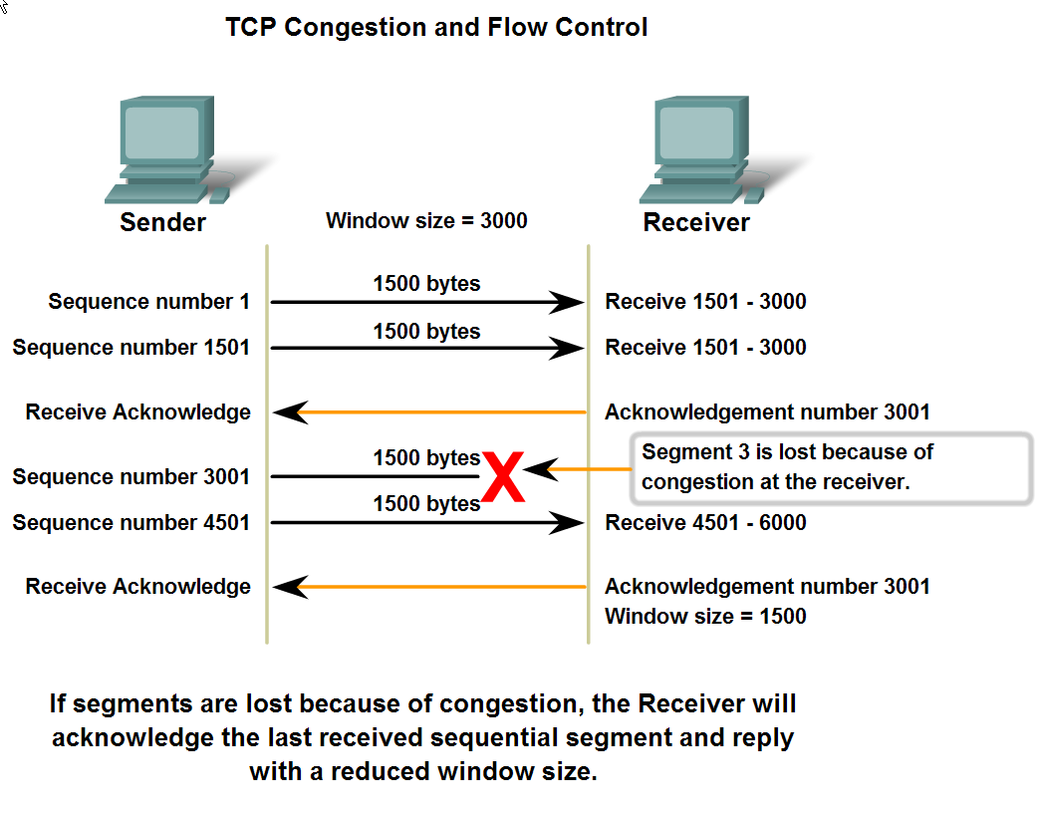
Managing TCP Sessions
Describe the mechanisms in TCP that manage the interrelationship between window size, data loss and congestion during a session

Slide 17
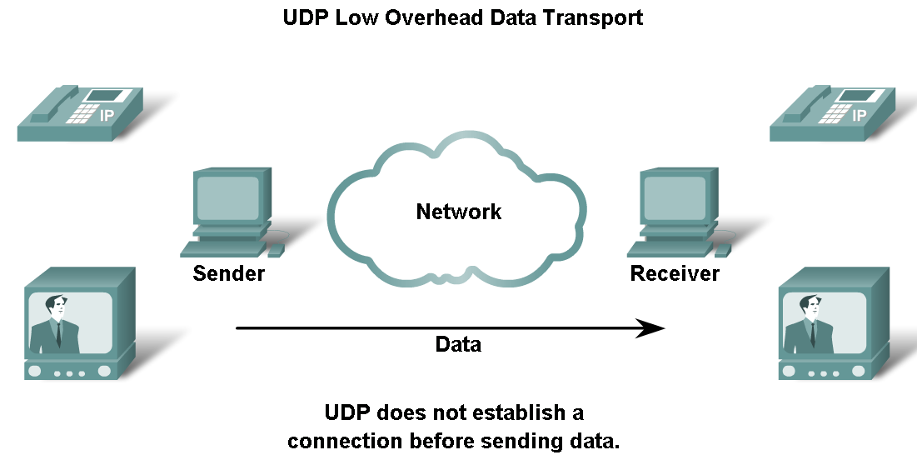
UDP Protocol
Describe the characteristics of the UDP protocol and the types of communication for which it is best suited

Slide 18
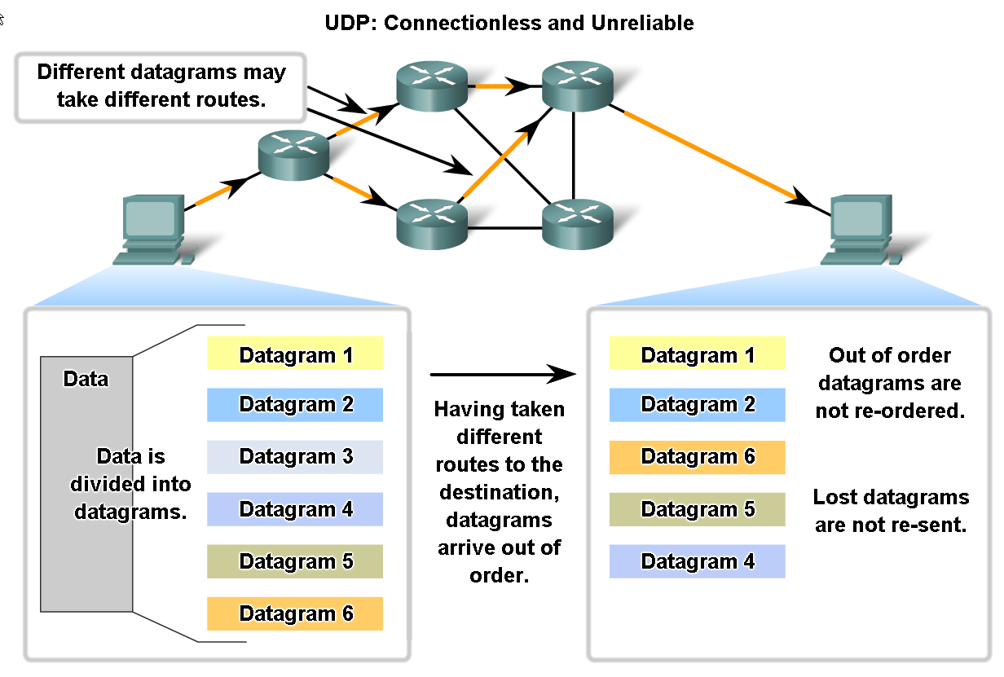
UDP Protocol
Describe in detail the process specified by the UDP protocol to reassemble PDUs at the destination device

Slide 19
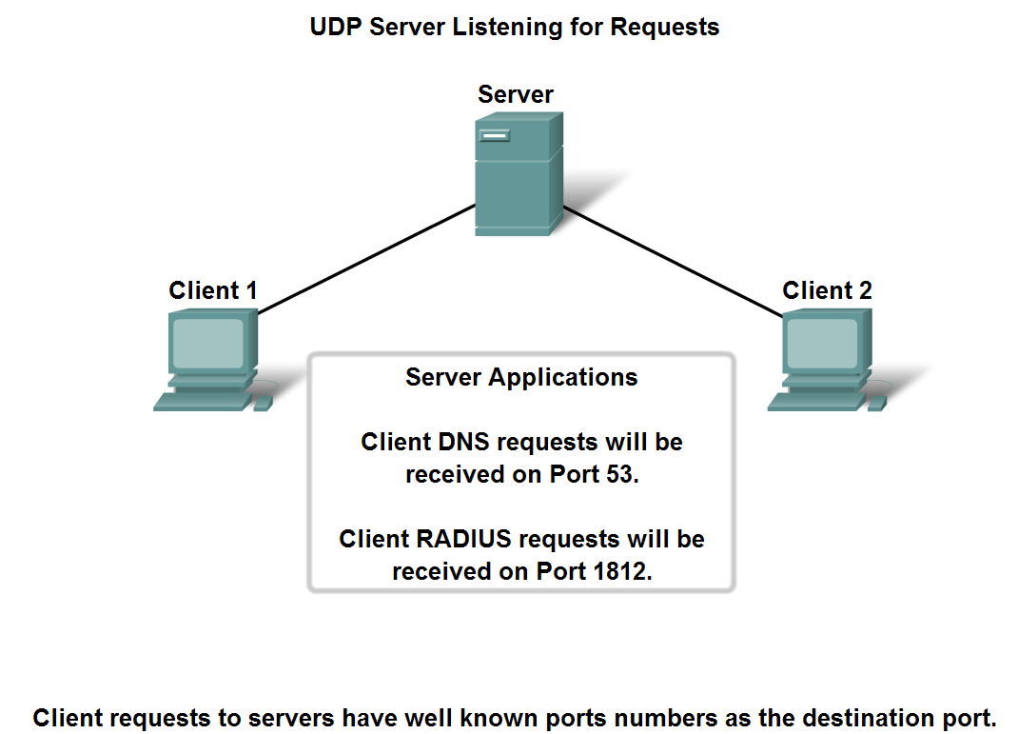
UDP Protocol
Describe how servers use port numbers to identify a specified application layer process and direct segments to the proper service or application

Slide 20
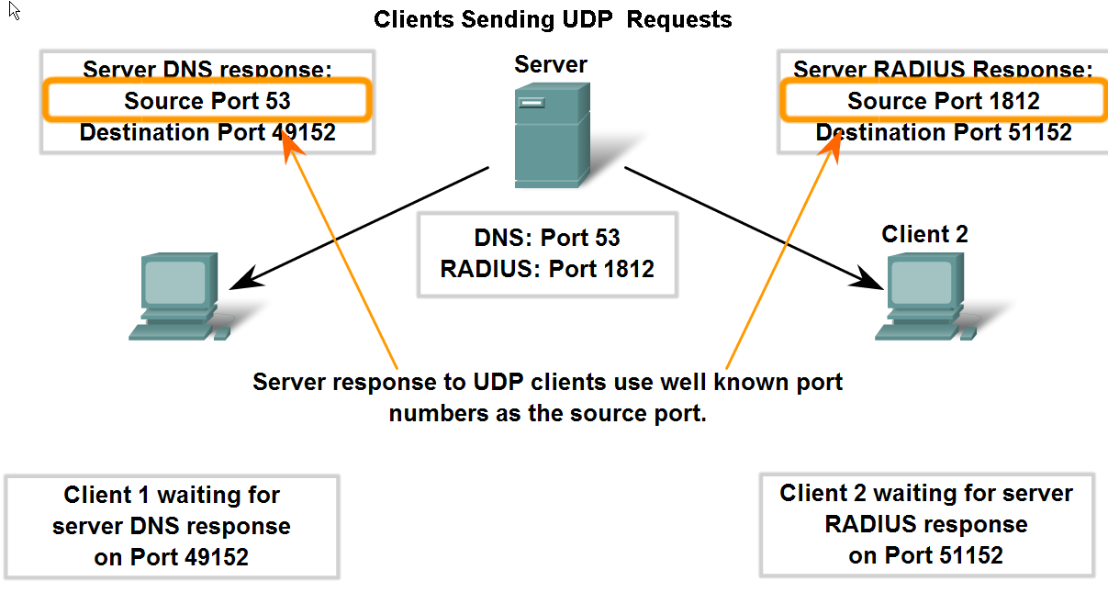
UDP Protocol
Trace the steps as the UDP protocol and port numbers are utilized in client-server communication

Slide 21
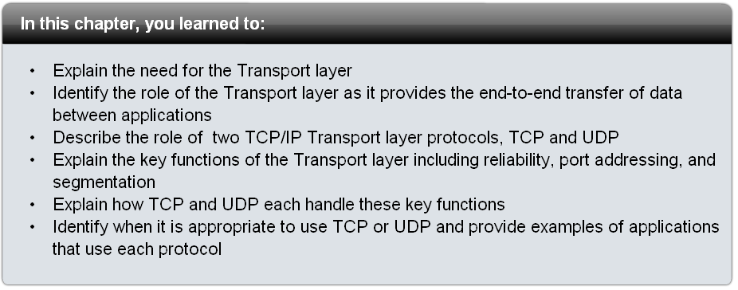
Summary

